Slide 1


Sri Yenigalla
11/19/2022

Slide 2

Outline
Executive Summary
Introduction
Methodology
Results
Conclusion
Appendix

Slide 3
Executive Summary
In this assignment, we will predict if the Falcon 9 first stage will land successfully. SpaceX advertises Falcon 9 rocket launches on its website with a cost of 62 million dollars; other providers cost upward of 165 million dollars each, much of the savings is due to the fact that SpaceX can reuse the first stage. We analyzed the success rate of Falcon9 launches with data collected from public SpaceX API and SpaceX Wikipedia page. Explored data using SQL, visualization, folium maps, and Plotly dashboards. Relevant columns were used as features by changing all categorical variables into binary using one hot encoding. Standardized data and used GridSearchCV to find best parameters for machine learning models.
Following machine learning models were built and tested: Logistic Regression, Support Vector Machine, Decision Tree Classifier, and K Nearest Neighbors. All produced similar results with accuracy rate of about 83.33%. All models over predicted successful landings. More data is needed for better model determination and accuracy.

Slide 4
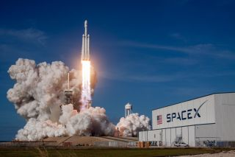
Introduction
Context
SpaceX made major leaps in efficient rocket launches using Falcon 9
Major savings with a cost of 62 million dollars per launch vs other providers costing upward of 165 million dollars each
Much of the savings is because SpaceX can reuse the first stage. Therefore if we can determine if the first stage will land, we can determine the cost of a launch.
Problem
Space Y wants to use machine learning techniques to predict the success of Stage 1 recovery

Slide 5

Section 1

Slide 6
Methodology
Executive Summary
Data collection methodology:
API calls were made to Space X public API and web scraping from Space X’s Wikipedia.
Perform data wrangling
Training labels were used to convert categorical data into numeric for regression analysis along with creation of adding columns ‘Mission Outcome’ and ‘Landing Location’
Perform exploratory data analysis (EDA) using visualization and SQL
Perform interactive visual analytics using Folium and Plotly Dash
Perform predictive analysis using classification models
How to build, tune, evaluate classification models

Slide 7
Data Collection
API requests were made to Space X public API and tables were sourced from Wikipedia HTML page using web scraping.
Requested data was cleaned, parsed and converted into a Pandas dataframe with columns as shown below from each source.
Space X API | Web scraping from Wikipedia
BoosterVersion | Flight No.
PayloadMass | Launch Site
Orbit | Payload
LaunchSite | Payload mass
Outcome | Orbit
Flights | Customer
GridFins | Launch outcome
Reused | Version Booster
Legs | Booster landing
LandingPad | Date
Block | Time
ReusedCount
Serial
Longitude
Latitude

Slide 8
Data Collection – SpaceX API
Pull data from SpaceX API using requests.get()
Decode response content using .json()
Convert the content into Pandas dataframe using .json_normalize()
Use API calls again on the columns ‘rocket’, ‘payloads’, ‘launchpad’ and ‘cores’ to get more data on launches
Combine all the columns into dictionary
Create Pandas dataframe by type casting the dictionary
Filter the dataframe for Falcon9 launches only
Replace any null values with the mean values.
GitHub URL: https://github.com/Raghava33/DataScience-Certification-Capstone-project/blob/799293333451cabb741c6e5de768d1d4bd4c1620/Week%201/Data%20Collection%20API.ipynb

Slide 9
Data Collection - Scraping
Pull data from Wikipedia HTML using requests.get()
Create BeautifulSoup object from HTML response
Extract all column/variable names from the HTML table header
Using ‘find_all’ function, extract tables from BeautifulSoup object
Extract the third table and create a data frame by parsing the HTML tables
Extract launch records from table rows and create a dictionary with them
Type cast the dictionary to DataFrame
GitHub URL: https://github.com/Raghava33/DataScience-Certification-Capstone-project/blob/799293333451cabb741c6e5de768d1d4bd4c1620/Week%201/Data%20collection%20web%20scraping.ipynb

Slide 10
Data Wrangling
In the data set there are several different cases where the booster did not land successfully. Sometimes a landing was attempted but failed due to an accident; for example, True Ocean means the mission outcome was successfully landed to a specific region of the ocean while False Ocean means the mission outcome was unsuccessfully landed to a specific region of the ocean. True RTLS means the mission outcome was successfully landed to a ground pad False RTLS means the mission outcome was unsuccessfully landed to a ground pad. True ASDS means the mission outcome was successfully landed on a drone ship False ASDS means the mission outcome was unsuccessfully landed on a drone ship.
In this section, we will mainly convert those outcomes into Training Labels with 1 means the booster successfully landed 0 means it was unsuccessful.
Calculate number of launches on each site
Calculate the number and occurrence of each orbit
Calculate the number and occurence of mission outcome per orbit type
Create a landing outcome label from Outcome column
GitHub URL: https://github.com/Raghava33/DataScience-Certification-Capstone-project/blob/799293333451cabb741c6e5de768d1d4bd4c1620/Week%201/EDA%20lab.ipynb

Slide 11
EDA with Data Visualization
Exploratory Data Analysis with Visualization was performed on: Flight Number, Payload Mass, Launch Site, Orbit, Class and Year.
Following variable relationships were plotted:
Flight Number vs. Payload Mass, Flight Number vs. Launch Site, Payload Mass vs. Launch Site, Orbit vs. Success Rate, Flight Number vs. Orbit, Payload vs Orbit, and Success Yearly Trend
Scatter plots, line charts, and bar plots were used to explore relationships between variables to see if they are fit for training the machine learning models
GitHub URL: https://github.com/Raghava33/DataScience-Certification-Capstone-project/blob/799293333451cabb741c6e5de768d1d4bd4c1620/Week%202/EDA%20with%20Visualization.ipynb

Slide 12
EDA with SQL
Load data into IBM database and query the data into the notebook using the IBM DB2 credential information and implement queries using SQL magic. Following queries were performed to understand the data through EDA.
Display the names of the unique launch sites in the space mission
Display 5 records where launch sites begin with the string 'CCA’
Display the total payload mass carried by boosters launched by NASA (CRS)
Display average payload mass carried by booster version F9 v1.1
List the date when the first succesful landing outcome in ground pad was achieved
List the names of the boosters which have success in drone ship and have payload mass greater than 4000 but less than 6000
List the total number of successful and failure mission outcomes
List the names of the booster_versions which have carried the maximum payload mass, using subquery
List the records which will display the month names, failure landing_outcomes in drone ship ,booster versions, launch_site for the months in year 2015
Rank the count of successful landing_outcomes between the date 04-06-2010 and 20-03-2017 in descending order
GitHub URL: https://github.com/Raghava33/DataScience-Certification-Capstone-project/blob/6ed5158dd8d3a85502aaebbd36c8edc6494970a4/Week%202/EDA%20with%20SQL%20skillslab.ipynb

Slide 13
Build an Interactive Map with Folium
Circles were used to mark the launch site locations. Markers were used to display more labels once we goto a particular launch site. In case of multiple sites in nearby locations, Marker cluster object was used to display markers as we zoom into the map.
Marker color was used to distinguish between successes and failures linked to launch sites.
MousePosition was used to interactively locate nearby sites such as railway lines, coastlines, etc.
PolyLine was used to draw lines between two points and distance between those points was labeled using an attribute of Marker.
The launch success rate may depend on many factors such as payload mass, orbit type, and so on. It may also depend on the location and proximities of a launch site, i.e., the initial position of rocket trajectories. Finding an optimal location for building a launch site certainly involves many factors, so we added above objects to discover some of the factors by analyzing the existing launch site locations.
GitHub URL: https://github.com/Raghava33/DataScience-Certification-Capstone-project/blob/111a33a5ea3d41ba4fc9185a5659196c7982b050/Week%203/Interactive%20map%20with%20Folium.ipynb

Slide 14
Build a Dashboard with Plotly Dash
Pie chart and scatter plot were used in the dashboard.
Pie chart can be selected to show distribution of successful landings across all launch sites and can be selected to show individual launch site success rates.
Scatter plot takes two inputs: Site (All or individual) and payload mass
Scatter plot also limits the data based on the slider selection between 0 and 10000 kg.
The pie chart visualizes the launch site success rate, whereas the scatter plot shows how success varies across launch sites, payload mass, and booster version category.
GitHub URL: https://github.com/Raghava33/DataScience-Certification-Capstone-project/blob/111a33a5ea3d41ba4fc9185a5659196c7982b050/Week%203/spacex_dash_app.py

Slide 15
Predictive Analysis (Classification)
Define the dependent variable separately as a series by converting column ‘class’ into numpy object and store in Y
Standardize the data in rest of the dataframe by using StandardScalar from preprocessing library and apply .fit_transform() and store in X
Use the function train_test_split to split the data X and Y into training and test data. Set the parameter test_size to 0.2 and random_state to 2
Create regression objects for following models: Logistic Regression, SVM, DecisionTreeClassifier, and KNeighboursClassifier
Fit each model using GridSearchCV (cv=10) to find optimal parameters for each model from a given hyper-parameter grid
Calculate the accuracy on the training data using the method ’score’ for optimal parameters
Calculate the accuracy on the test data using the method ’score’
Predict the outcome using test data and plot confusion matrix for each model.
Use barplot to compare the accuracy of all models on test data
GitHub URL: https://github.com/Raghava33/DataScience-Certification-Capstone-project/blob/111a33a5ea3d41ba4fc9185a5659196c7982b050/Week%204/IBM-DS0321EN-SkillsNetwork_labs_module_4_SpaceX_Machine_Learning_Prediction_Part_5.jupyterlite.ipynb

Slide 16
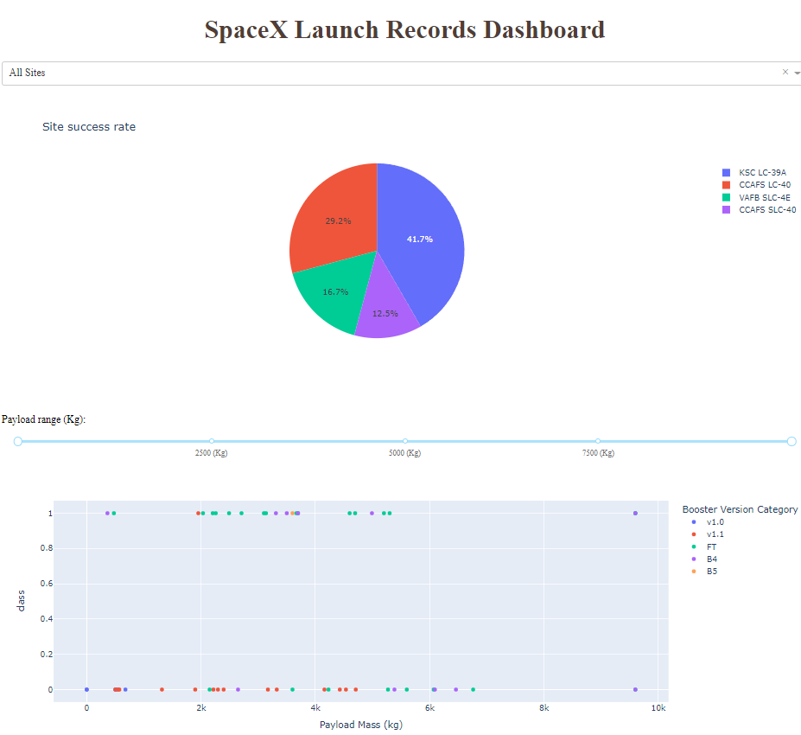
Results
Results for EDA and all other sections are shown in following slides and insights are shared in conclusions slide
Model | Accuracy
Logistic Regression | 83.3%
Support Vector Machine | 83.3%
Decision tree classifier | 77.8%
K Nearest Neighbours | 83.3%

Slide 17

Section 2

Slide 18
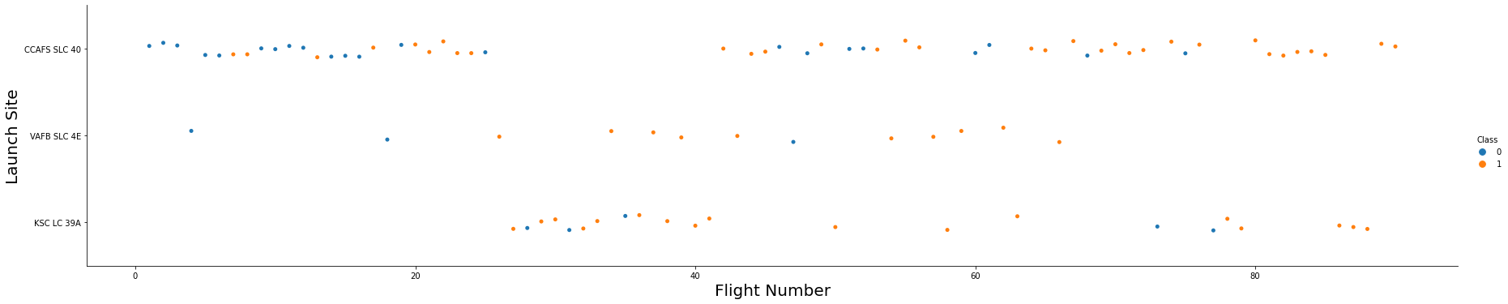
Flight Number vs. Launch Site
Successes increased gradually with major regime change after around flight #25. Seems like the techniques were refined until flight #80 whereafter there were no failures
Most of the flights were launched from ‘CCAFS SLC 40’, except the flight numbers between 25-40, where new launch sites were tried.
Most of the flights between 25-40 were launched from ‘KSC LC 39A’ and most of them were success. ‘VAFB SLC 4E’ had 100% success rate for these flights.

Slide 19
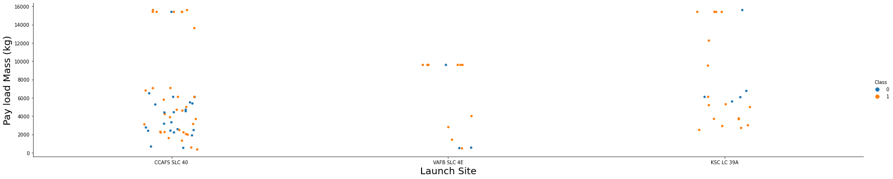
Payload vs. Launch Site
Success rate is higher for pay load mass above 8000kg for all launch sites.
Launch sites ‘VAFB SLC 4E’ and ‘KSC LC 39A’ have higher success rate than ‘CCAFS SLC 40’. This could be because most of the early launches were from ‘CCAFS SLC 40’.

Slide 20
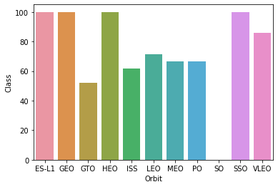
Success Rate vs. Orbit Type
Above bar chart shows the success as a percentage.
Only four orbits have 100% success rate and one has 0%. Most of the remaining orbits have around 60% success rate

Slide 21
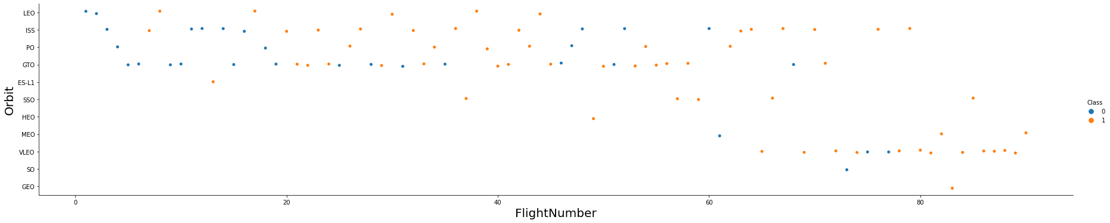
Flight Number vs. Orbit Type
Most launches were made to the orbits ‘LEO’, ‘ISS’, ‘PO’, ‘GTO’, with gradually expanding to other orbits with major trend change after flight #60.
Successes also increased gradually after flight #50 and entering into new orbits. There weren’t as many failures early in the new orbits unlike ones below flight #20. Seems like Space X adopted to the new orbits well from past experience and refinement.

Slide 22
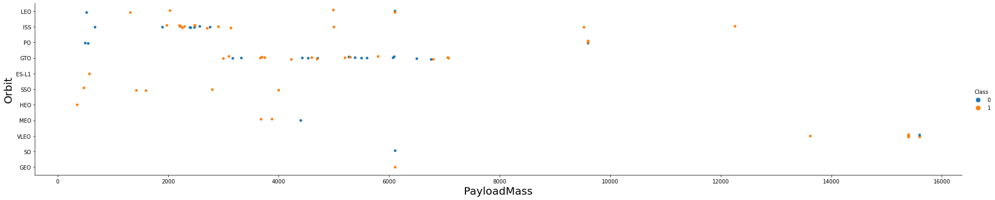
Payload vs. Orbit Type
Orbits are related to Payload mass. For example, SSO, MEO and HEO have payload masses below 5000kg, where VLEO has a mass only above 13,000kg.
GTO’s payload is below 7000kg

Slide 23
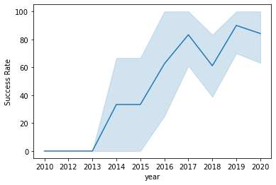
Launch Success Yearly Trend
Success rate kept increasing since 2013, until 2020 with a small dip in 2018

Slide 24
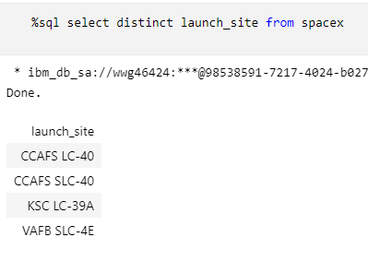
All Launch Site Names
CCAFS SLC-40, CCAFS LC-40, KSC LC-39A, VAFB SLC-4E
Use distinct function

Slide 25
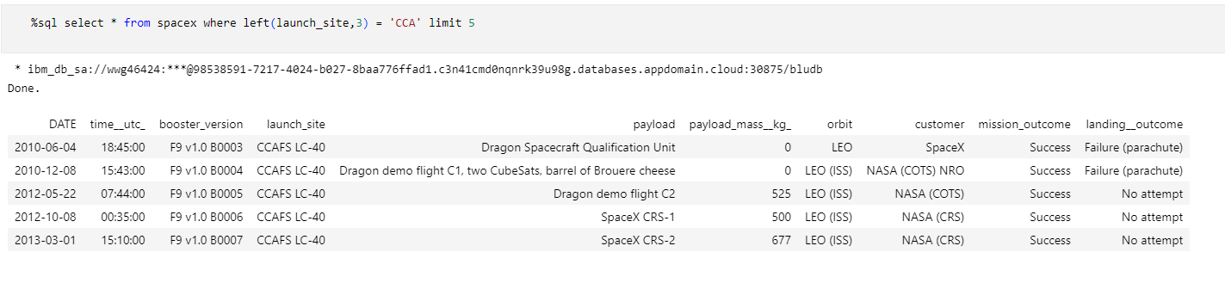
Launch Site Names Begin with 'CCA'
First 5 records starting with CCA

Slide 26
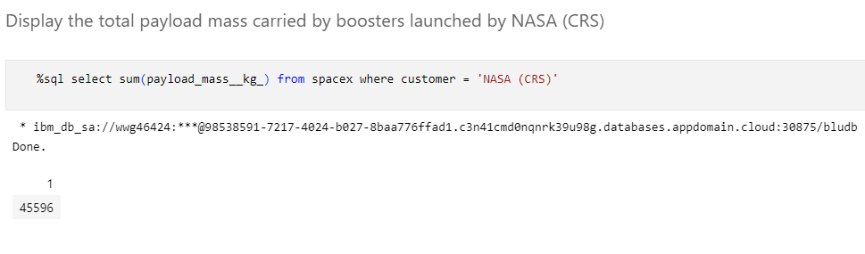
Total Payload Mass
Total payload mass from NASA(CRS) is 45,596kg

Slide 27
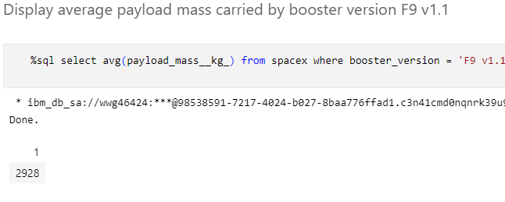
Average Payload Mass by F9 v1.1
Average Payload mass from booster version ‘F9 v1.1’ is 2,928kg

Slide 28
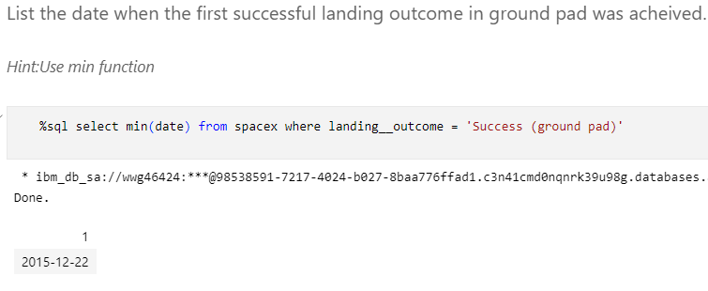
First Successful Ground Landing Date
First successful ground landing date is 22nd Dec 2015. I got a different date in Github when running it outside Watson Studio as I ran out of subscription (for last two tasks), but I have both versions of the files. Please see the Watson version below for this result. Skills lab version was used in main slide.
Github URL: https://github.com/Raghava33/DataScience-Certification-Capstone-project/blob/799293333451cabb741c6e5de768d1d4bd4c1620/Week%202/EDA%20with%20SQL.ipynb

Slide 29
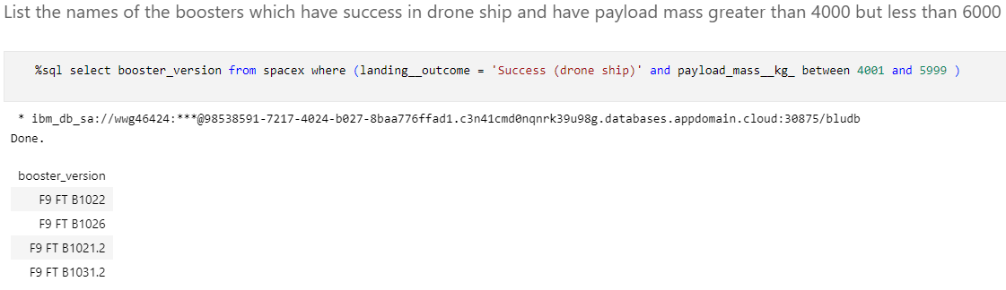
Successful Drone Ship Landing with Payload between 4000 and 6000
Boosters which have successfully landed on drone ship and had payload mass greater than 4000 but less than 6000 all start with ‘F9 FT B10’

Slide 30
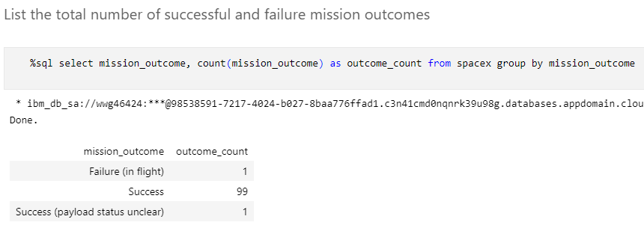
Total Number of Successful and Failure Mission Outcomes
SpaceX has 98% success rate

Slide 31
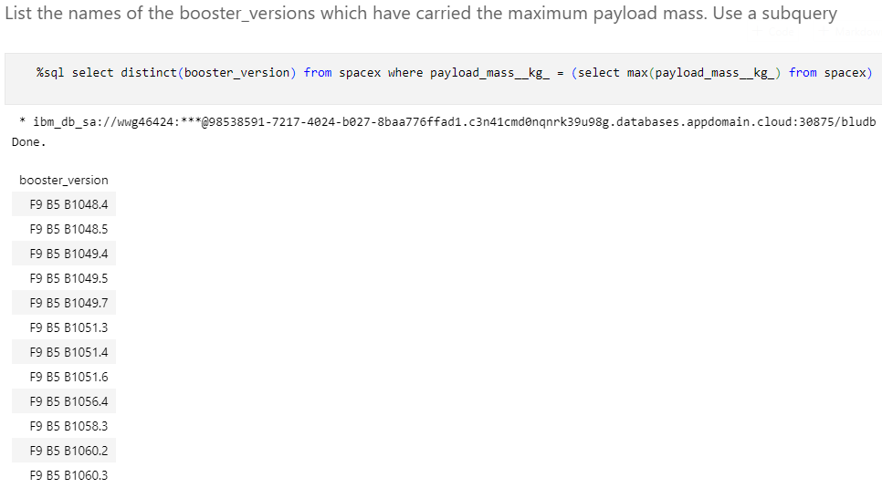
Boosters Carried Maximum Payload
List of boosters with Maximum payload mass

Slide 32
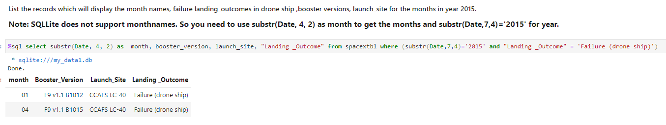
2015 Launch Records
We have 2 failed landing outcomes in January and April
As shown in the screenshot, Skillslab doesn’t support monthname, it is instead extracted as a number using the formula provided by IBM.

Slide 33
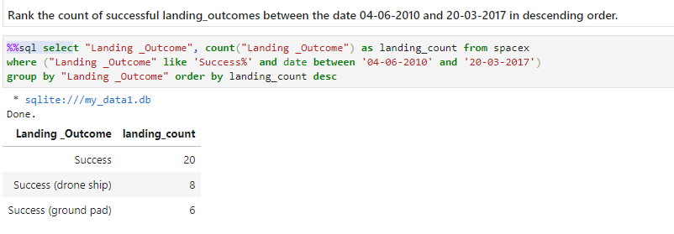
Rank Landing Outcomes Between 2010-06-04 and 2017-03-20
There were a total of 34 successful landings, out of which 8 are on drone ship and 6 are on ground pad

Slide 34

Section 3

Slide 35
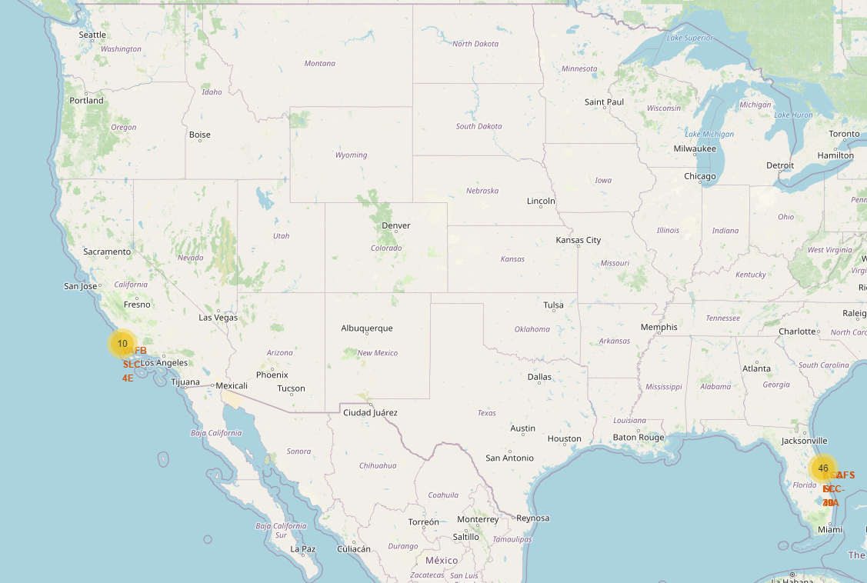
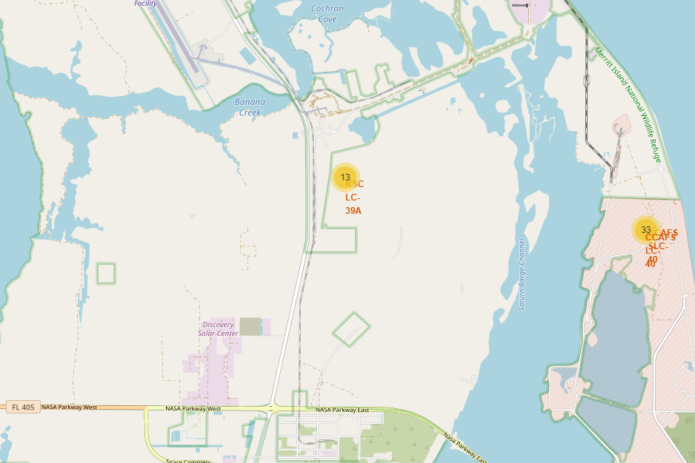
Launch site markers
On the left is the USA map, on right is only the east coast.
All launch sites are close to the ocean, with most of them located on east coast

Slide 36
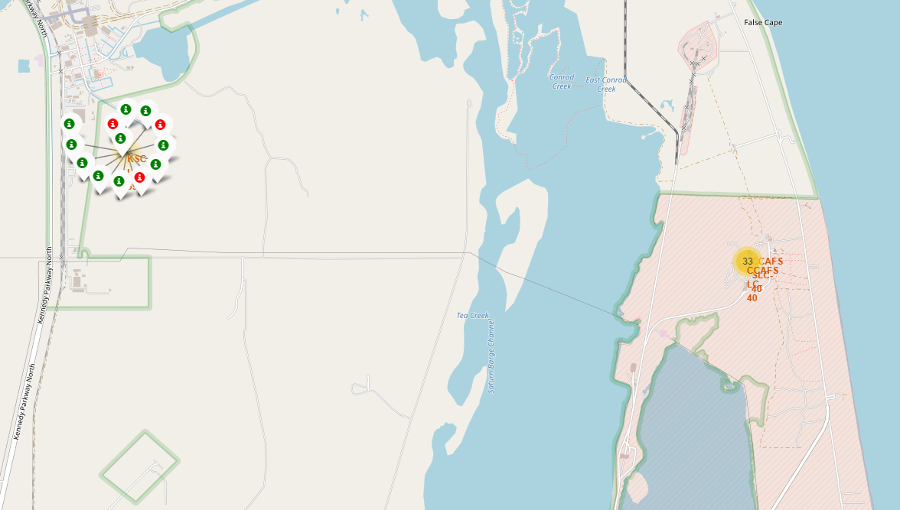
Map of markers with success rate
Above map shows the east coast KSC LC 39A launch site success markers. Green is success and red is failure.

Slide 37
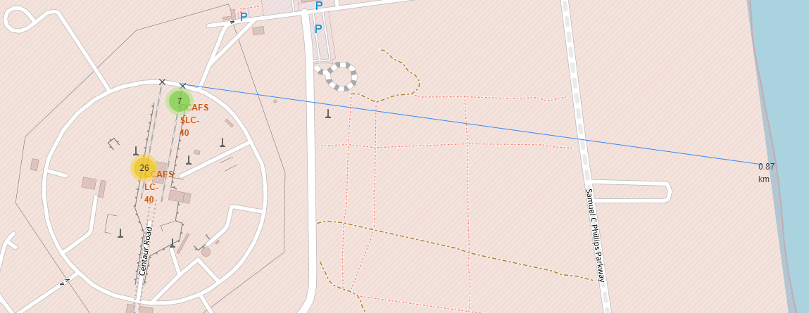

Distance to east coastline
Distance from CCAFS SLC 40 is calculated as 0.87km (highlighted in yellow) and shown on the line (blue). Launch sites are located close to the coast to facilitate water landings and to keep population away from the explosions. They are also usually close to the transportation like railways.

Slide 38

Section 4

Slide 39
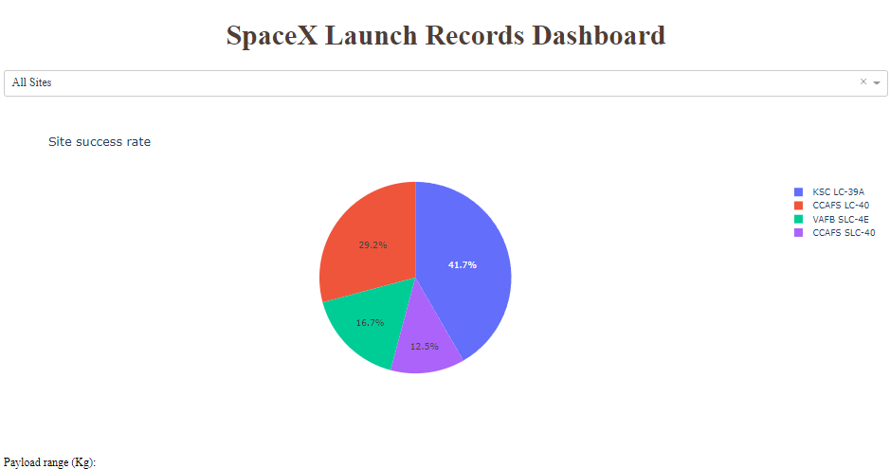
Success rate across all launch sites
KSC LC 39A has the highest success rate, followed by CCAFS LC-40 and VAFB SLC 4E

Slide 40
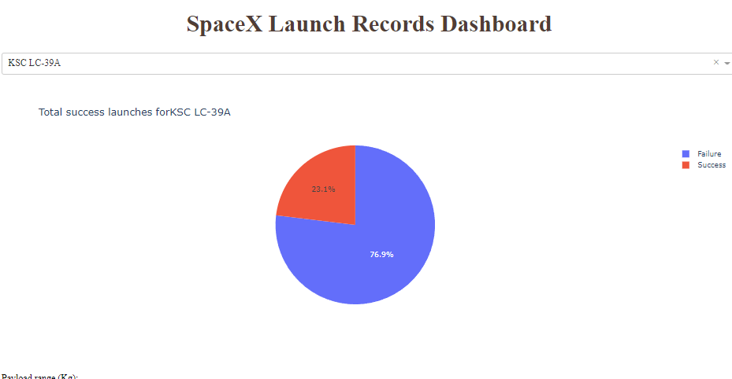
Success pie chart for KSC LC-39A
Although this site has the highest success rate, it is only 23.1% which does not seem impressive. This shows how tough the space launches are.

Slide 41
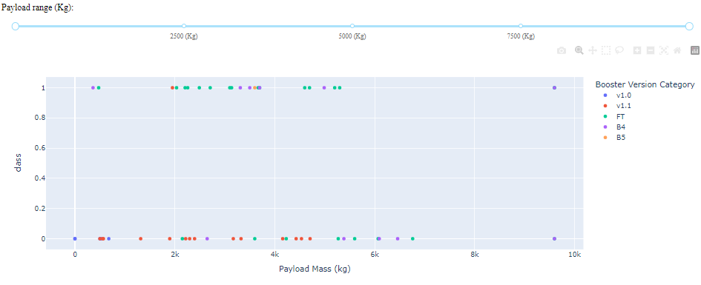
Success rate from Payload mass vs Launch Outcome
Plotly has a Payload range selector which is set from 0-10000. Class indicates 1 for successful landing and 0 for failure. Scatter plot also accounts for booster version category in color and number of launches in point size. In this particular range of 0-6000, there were two failed landings with payloads of zero kg.

Slide 42

Section 5

Slide 43
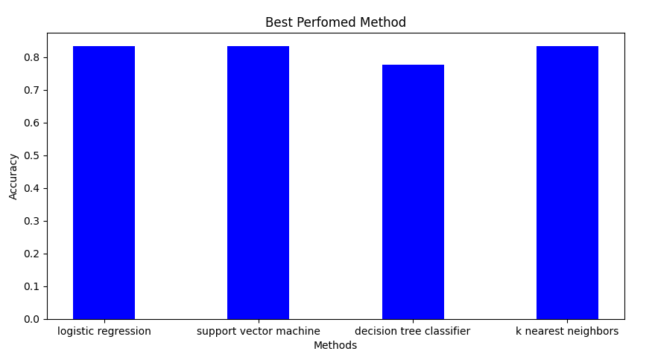
Classification Accuracy
All models have an accuracy of 83.3% except the Decision tree classifier which has an accuracy of 77.78%.
Only way to break the tie between the models is to use try and remove some of the independent variables, possibly using PCA (Principal Component Analysis)

Slide 44

Confusion Matrix
Confusion matrix is mostly same across all models.
The models predicted 12 successful landings when the true label was a successful landing.
The models predicted 3 unsuccessful landings when the true label was an unsuccessful landing.
The models predicted 3 successful landings when the true label was unsuccessful landings.
Models seem to over predict successful landings.

Slide 45
Conclusions
EDA helped establish relationships between various variables which seem to be correlated. So, it is a good idea to conduct PCA (Principal Component Analysis) to improve explanatory power of remaining variables.
Overall, the success rate is very high even when using k-fold validation for testing dataset.
Stage 1 landing is consistent and hence we can recommend Space Y that Space X is doing well.
Since most of the model predicted same accuracy, it is suggested to use PCA and extract more information from each model.
…

Slide 46
Appendix
Repo link:
https://github.com/Raghava33/DataScience-Certification-Capstone-project

Slide 47


